Slide 1
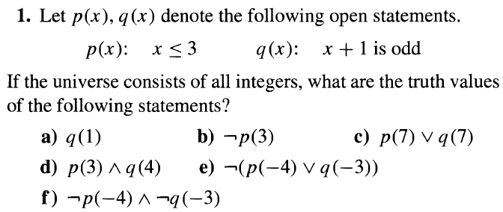
Mathematical Logic : Predicates and Quantifiers

Slide 2
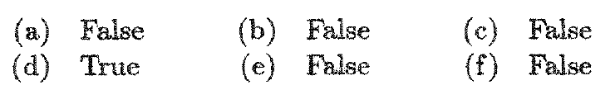
Mathematical Logic : Predicates and Quantifiers

Slide 3
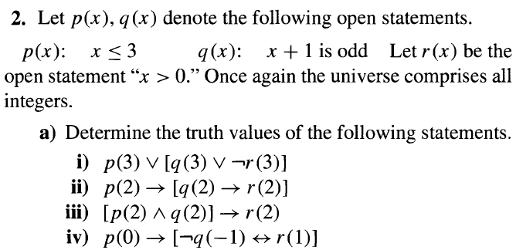
Mathematical Logic : Predicates and Quantifiers

Slide 4
Mathematical Logic : Predicates and Quantifiers

Slide 5
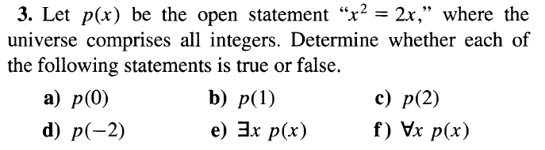
Mathematical Logic : Predicates and Quantifiers

Slide 6
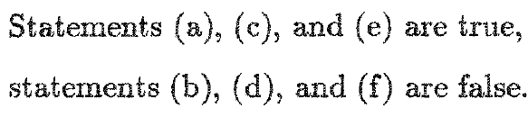
Mathematical Logic : Predicates and Quantifiers

Slide 7
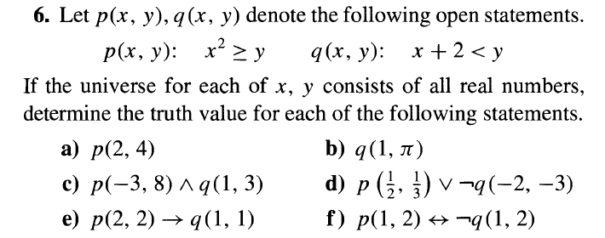
Mathematical Logic : Predicates and Quantifiers

Slide 8
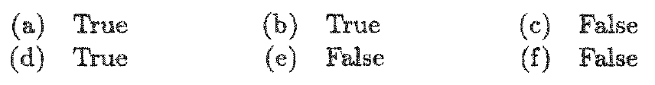
Mathematical Logic : Predicates and Quantifiers

Slide 9
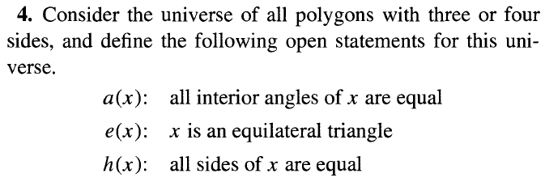
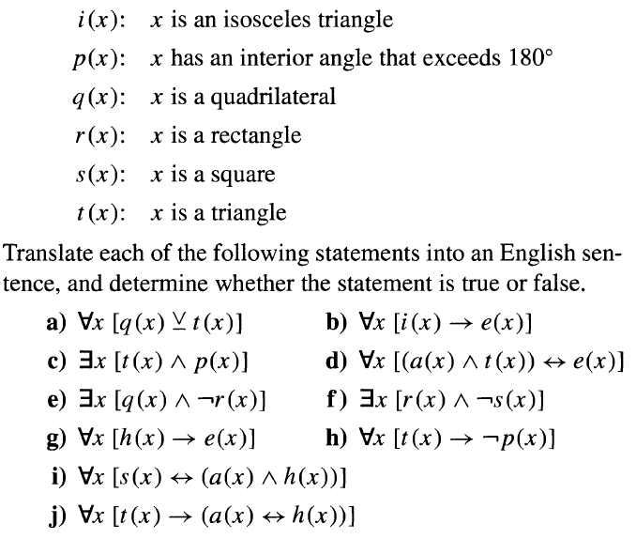
Mathematical Logic : Predicates and Quantifiers

Slide 10
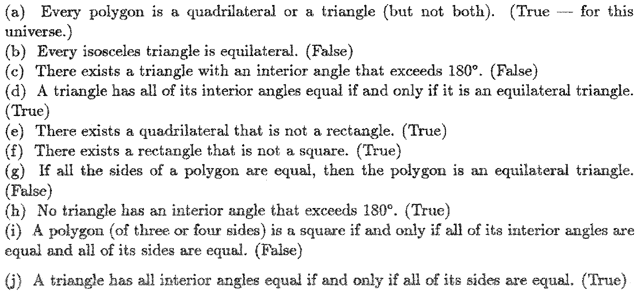
Mathematical Logic : Predicates and Quantifiers

Slide 11
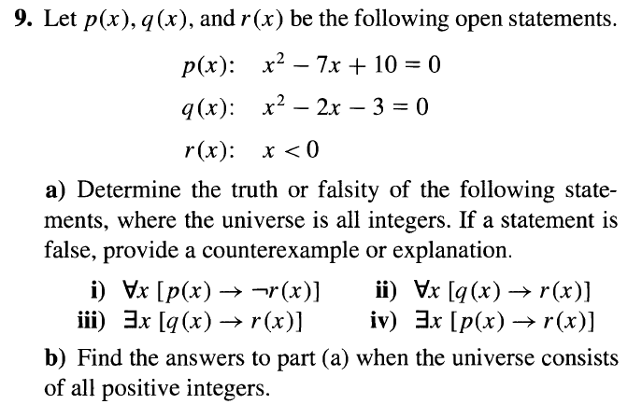
Mathematical Logic : Predicates and Quantifiers

Slide 12
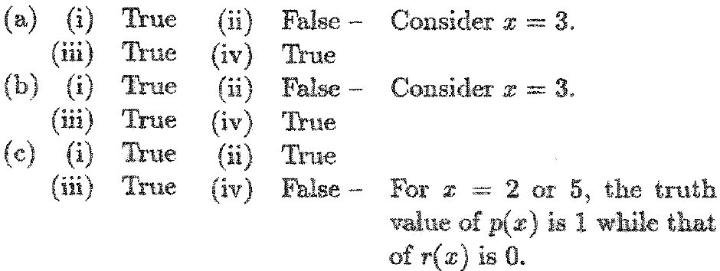
Mathematical Logic : Predicates and Quantifiers

Slide 13
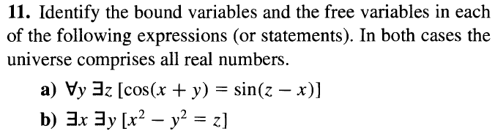
Mathematical Logic : Predicates and Quantifiers

Slide 14
Mathematical Logic : Predicates and Quantifiers

Slide 15
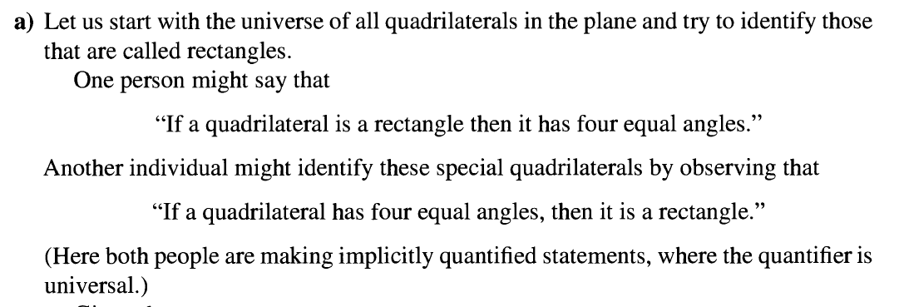
Mathematical Logic : Quantifiers, Definitions and proofs of Theorems

Slide 16
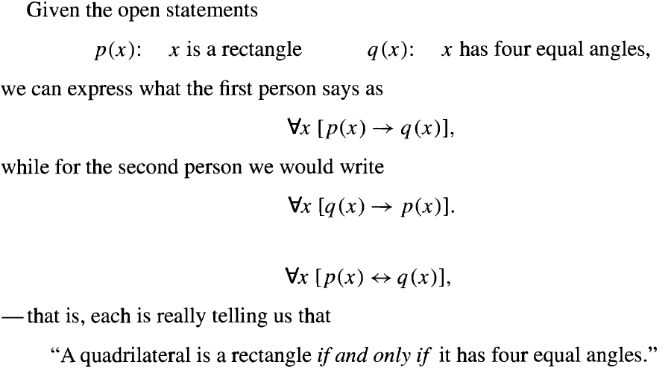
Mathematical Logic : Quantifiers, Definitions and proofs of Theorems

Slide 17
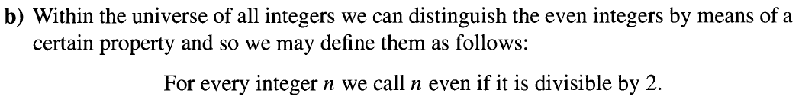
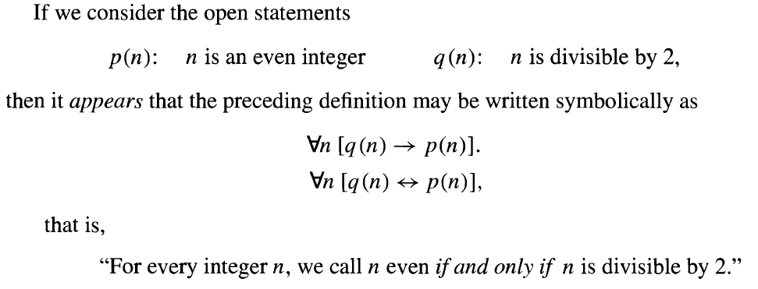
Mathematical Logic : Quantifiers, Definitions and proofs of Theorems

Slide 18
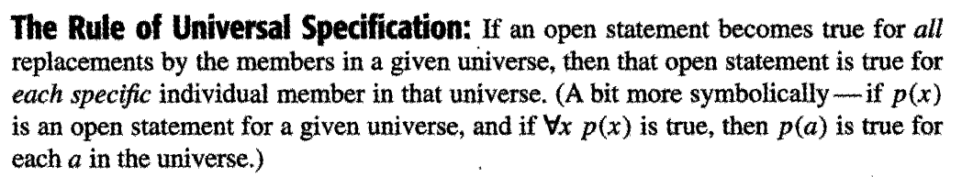
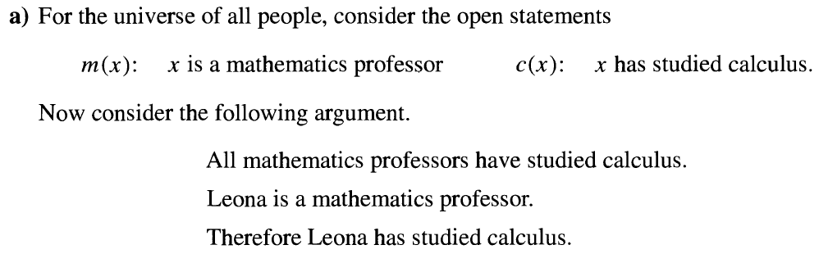
Mathematical Logic : Quantifiers, Definitions and proofs of Theorems

Slide 19
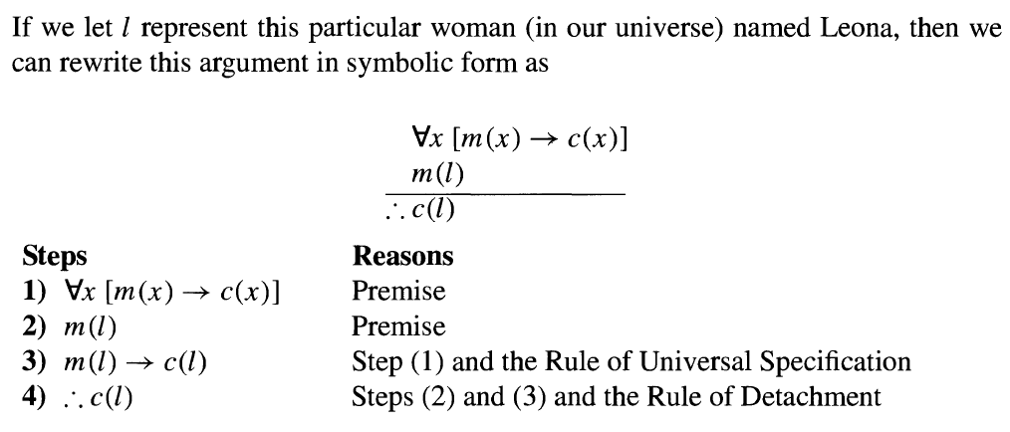
Mathematical Logic : Quantifiers, Definitions and proofs of Theorems

Slide 20
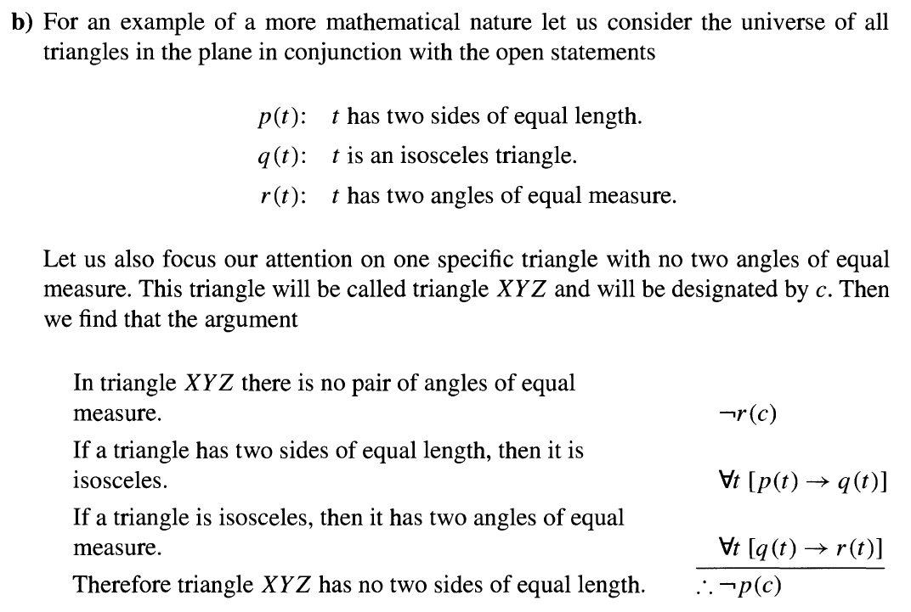
Mathematical Logic : Quantifiers, Definitions and proofs of Theorems

Slide 21
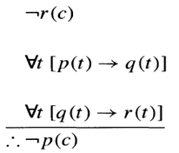
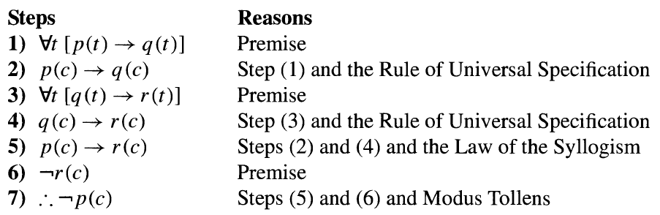
Mathematical Logic : Quantifiers, Definitions and proofs of Theorems

Slide 22
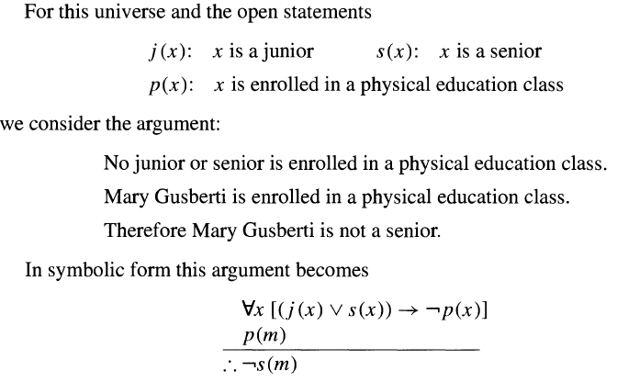
Mathematical Logic : Quantifiers, Definitions and proofs of Theorems

Slide 23

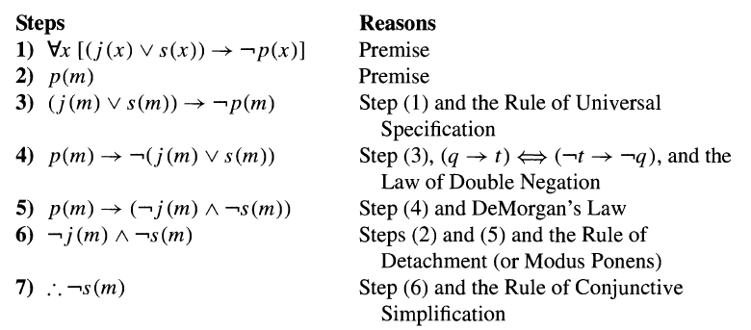
Mathematical Logic : Quantifiers, Definitions and proofs of Theorems

Slide 24
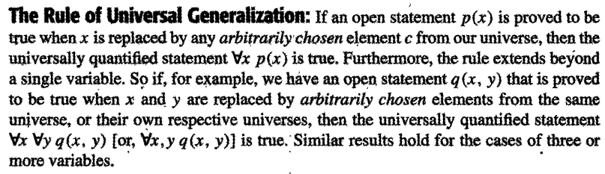
Mathematical Logic : Quantifiers, Definitions and proofs of Theorems

Slide 25
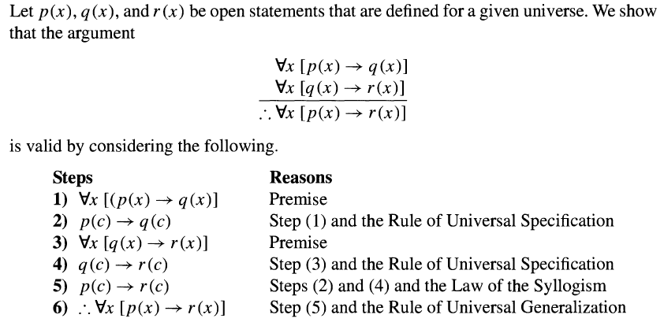
Mathematical Logic : Quantifiers, Definitions and proofs of Theorems

Slide 26
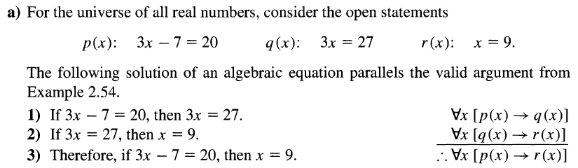
Mathematical Logic : Quantifiers, Definitions and proofs of Theorems

Slide 27
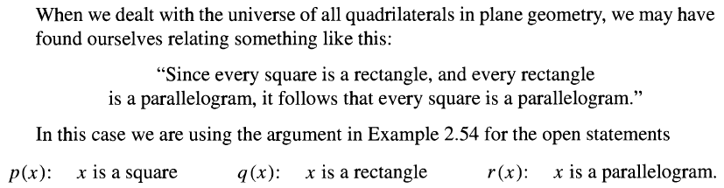
Mathematical Logic : Quantifiers, Definitions and proofs of Theorems

Slide 28

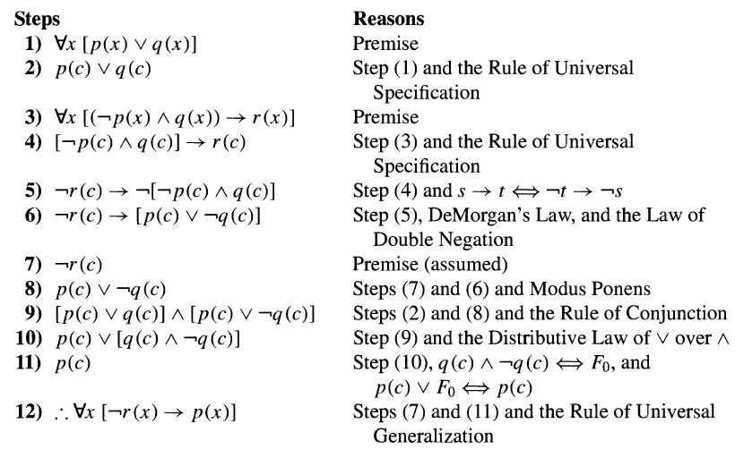
Mathematical Logic : Quantifiers, Definitions and proofs of Theorems

Slide 29
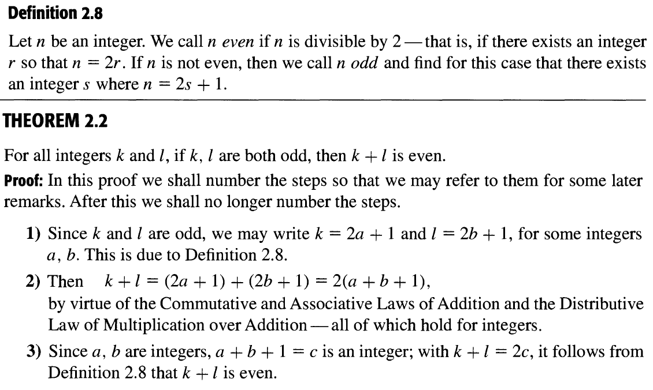
Mathematical Logic : Proofs of Theorems

Slide 30
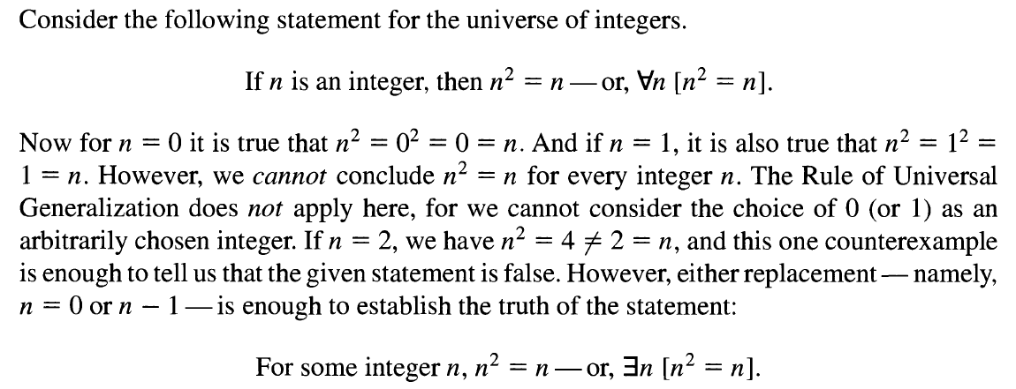
Mathematical Logic : Proofs of Theorems

Slide 31
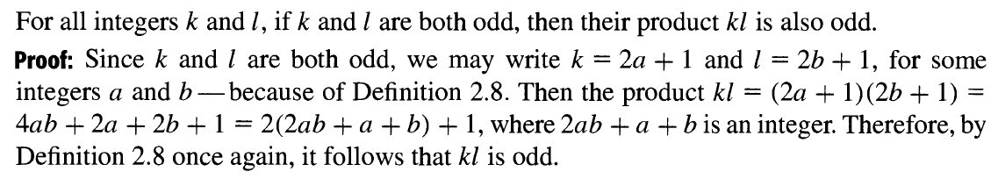
Mathematical Logic : Proofs of Theorems

Slide 32
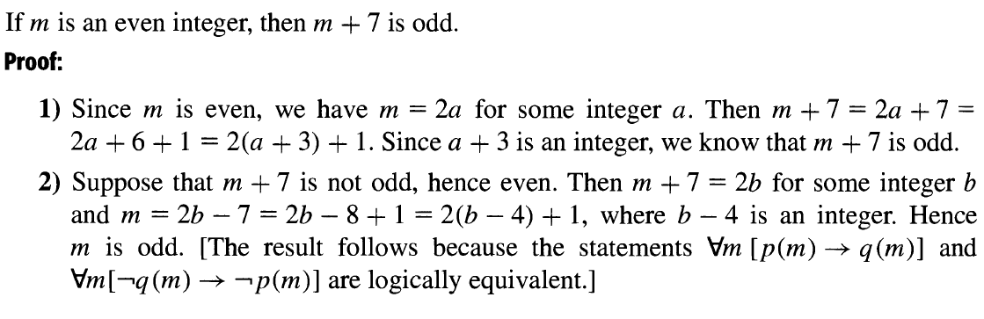
Mathematical Logic : Proofs of Theorems

Slide 33
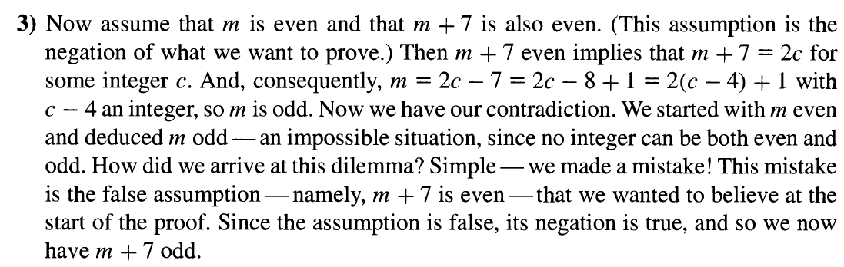
Mathematical Logic : Proofs of Theorems

Slide 34
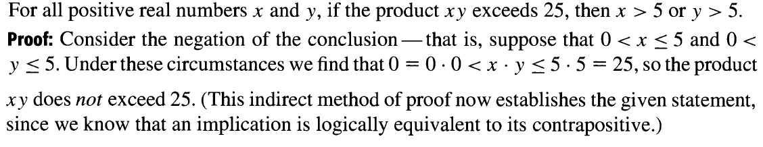
Mathematical Logic : Proofs of Theorems

